Slide 1

Navigating the Now: IRL
An interactive event for HE professionals passionate about staff engagement
Thursday 8th January 2026
Hosted by the University of Manchester and Jane Tidswell, People Insight
Notes:
Housekeeping – fire exits, toilets etc

Slide 2
What’s to come
11:30 AM
12:15 PM
1:00 PM
1:30 PM
2:15 PM
2:45 PM
| Keynote: University of Manchester
| Workshop: Action Planning with Generative AI
| Lunch 🥗
| Guest Session: Liverpool John Moores University
| Activity: Best Practice Exchange
| Close: Reflections & Next Steps
``````

Slide 3
Welcome to Navigating the Now: IRL
A chance to exchange insights on staff listening in Higher Education
Our Purpose
Share experiences, challenges & best practices
Build supportive community of practice
Connect colleagues across the HE sector
Learn from each other's successes and struggles
Notes:
Laurie

Slide 4



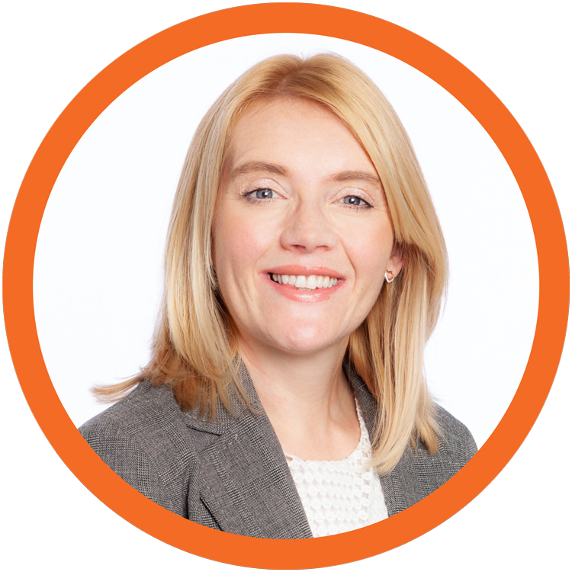











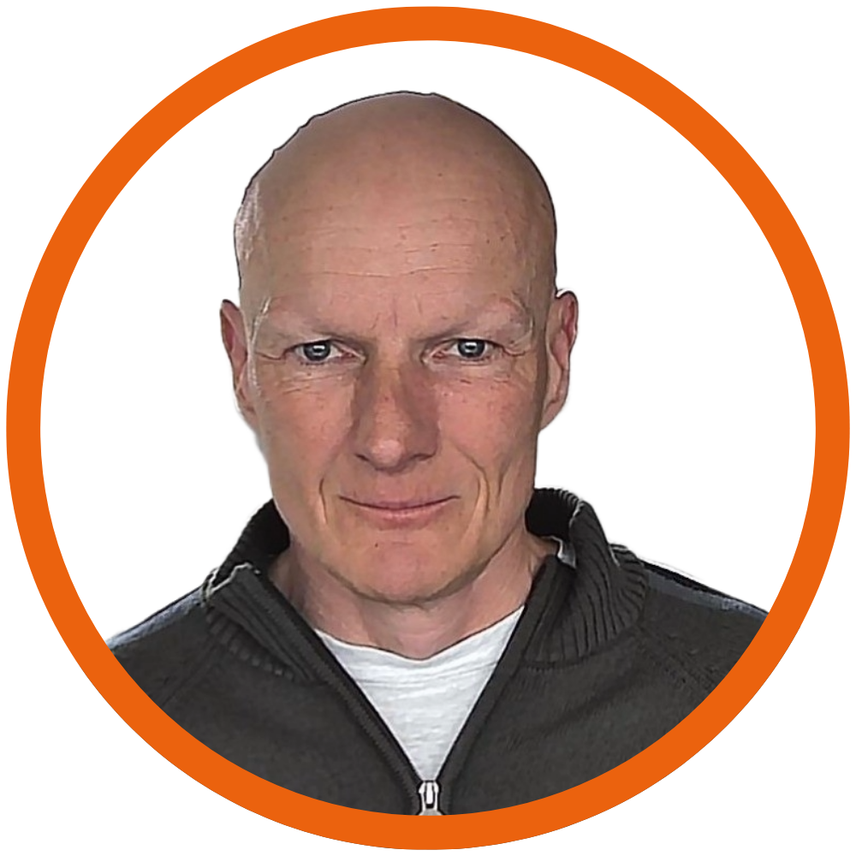










We have here today a range of HEIs and People Insight experts
Notes:
Claire + Mark W?

Slide 5
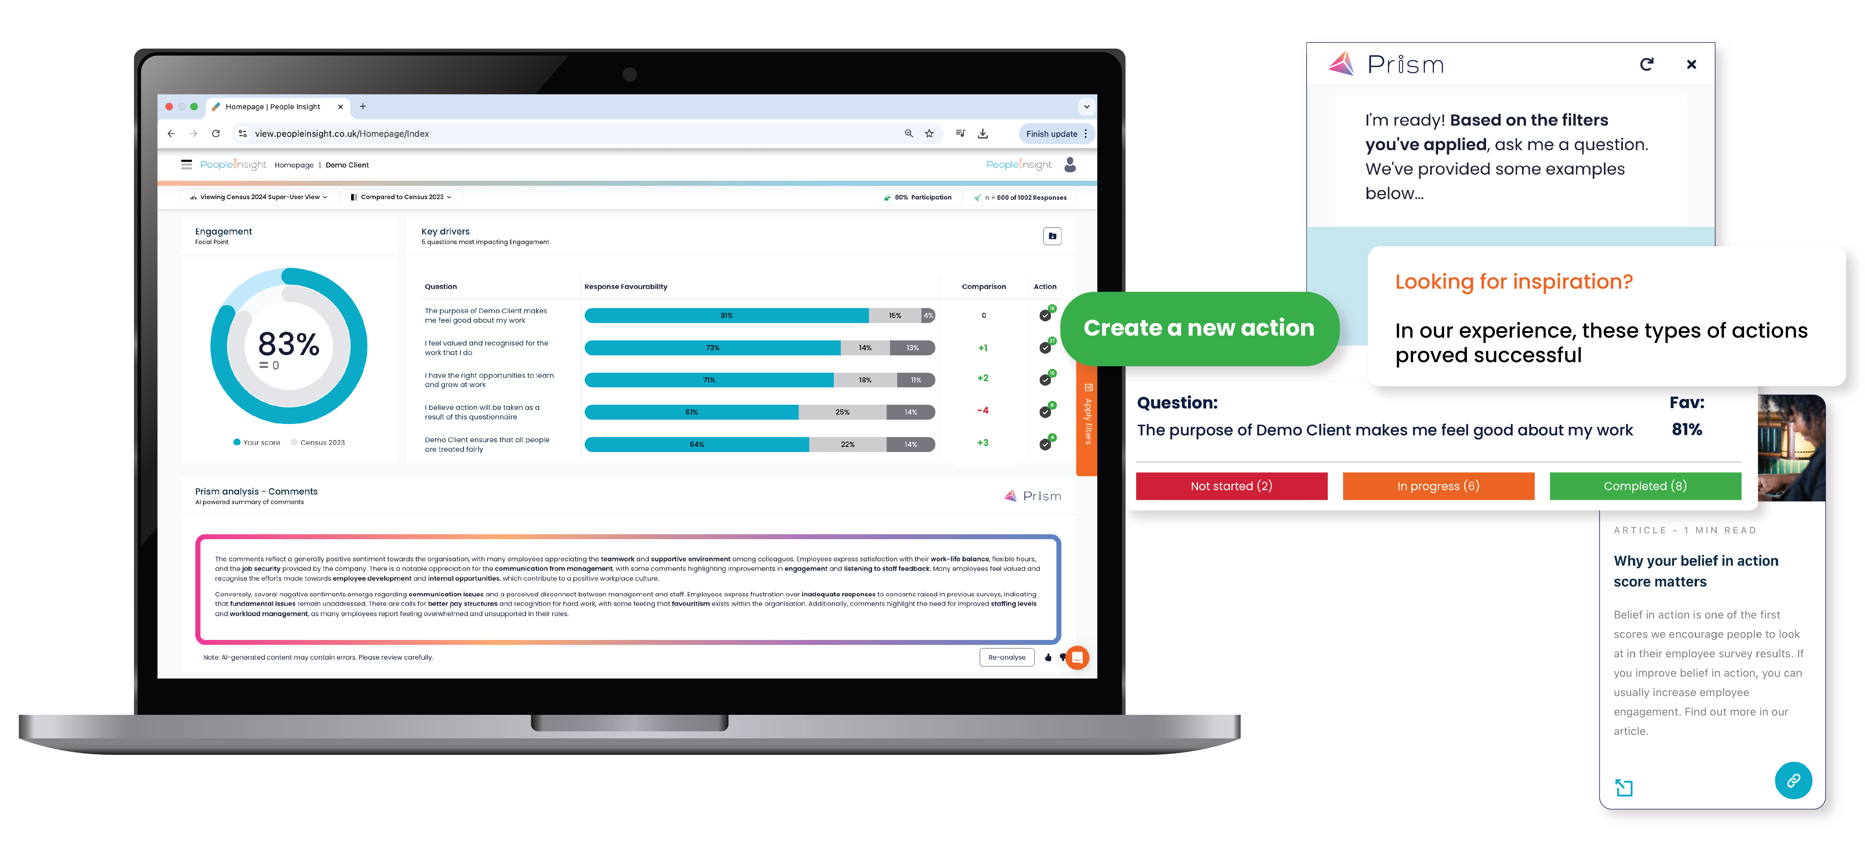



Sharper listening. Smarter action.
Move faster from employee feedback to improved engagement, culture and performance.
Listening in the moment with technology that brings clarity to employee feedback.
Helping people turn insight into action, with the right expertise and tools in place.

Slide 6




























































We are the #1 staff listening platform in Higher Education
6

Slide 7
We have the best benchmarking data in the industry
>75
2,000
400,000
Benchmarks
HE norm
International norm
Pre and Post 92
Russell Group
Academic
Professional Services
HEI Inspire norm
Faculty / department
75+ HEIs in our database
Over 2,000 HEI managers engaged
Over 400,000 UK HE employees empowered

Slide 8
Our strong (and growing!) HE community
Sector-specific insights
Events
HE Newsletter
Case studies
& our new HE Microsoft Teams Channel

Slide 9
2025: Driving engagement and action across Higher Education
Key milestones and measurable impact
Launched
⭐ Inspire ranking results
Delivered
👥 230,000 employees surveyed
Enhanced
📈 Benchmarking
📰 HE newsletter and Teams channel
📍8 overseas campuses
📊 21 executive presentations and 30+ manager workshops
✅ Post-survey action tools
🔷 Prism AI functionality
Notes:
Our external benchmarking – HE Inspire, HE International, HE <1,000 staff
Prism (Generative AI functionality) on the platform
The post survey activities working on key areas – 360s, Coaching, workshops, supporting in house leadership programmes

Slide 10
From 2024 to 2025
+2pp HE employee engagement improvement
+3pp HE belief in action improvement
+35% increase in dashboard activity (over 400,000 HE views/interactions)
Notes:
Yes, please the numbers below -
2025 Engagement = 76.7832608%;
2024 engagement = 75.0074462%
Belief in Action 2025 = 41.2808299570113%
Belief in Action 2024 = 38.4198759570113%
In terms of interactions of uni dashboard users with the dashboard app - it's seen a 35% increase in traffic in 2025 vs 2024.
2024 uni users -> 300,101 dashboard activities (viewing individual report pages in the dashboard)
2025 uni users -> 405,021 dashboard activities (viewing individual report pages in the dashboard)

Slide 11
Your Voice Matters
Our colleague listening journey
Rachael McGraw
Head of Colleague Experience
The University of Manchester

Slide 12
15,500 colleagues across Professional Services, three Faculties, nine Schools, four Cultural Institutions, multiple research institutes and partners like CRUK and the NHS
Notes:
One of the largest universities in the UK – 46,000 students from 160 countries
5th in the UK for research power (REF 2021) with 93% of research being world leading
Second in world for THE Impact Rankings
More work to be done on student satisfaction
Just celebrated our bicentenary and launched our new 10 year strategic plan and a major philanthropic and volunteering campaign Challenge Accepted.

Slide 13
Where we started
2013-2019
First ran a staff survey in 2013 and then every two years until 2019
Used Capita, focus on satisfaction rather than engagement
High response rates – 70% +, openly shared results, University actions
2021
Wellbeing pulse survey with People Insight
What works? Listening project resulting in our hybrid working approach
2022
Moved to one survey every three years working with People Insight
Large question set, academic-led steering group
50% response rate
Results not widely shared and action planning at University level only

Slide 14
2024: A new approach
Engaging senior stakeholders to build momentum for a continuous listening approach across colleagues and students
Launched our colleague experience surveys – joiners, one year and leavers
New President and V-C Duncan Ivison joined August 2024
Agreed to annual colleague engagement surveys starting in 2025
Commissioned People Insight and proposed refreshed approach with a firm focus on the PEARL model of engagement, transparent results sharing and empowering leaders to take action

Slide 15
2025: Exciting times!
Linked the survey to the development of our new ten-year strategy – Manchester 2035
Key message was that the survey would help shape M2035 - not just what we do but how we do it
Firmly positioning colleague engagement as a key enabler to delivering M2035
Built our community of Dashboard Users
Launched Your Voice Matters campaign: Colleague Voice | Your Voice Matters | StaffNet | The University of Manchester

Slide 16
Managers account for 70% of the variance in team employee engagement. Gallup, State of the Global Workplace Report 2025

Slide 17
How did we do in 2025?
Engagement score: 79% (+8% on 2022; +5% on HEI benchmark and +3% on Russell Group benchmark)
Response rate: 51% (RG average 58%)
Only 36% of colleagues believed action would take place as a result of the survey
Worked with our community of 225 Dashboard Users sharing results with them under embargo two weeks before going live across the University
Lots of support and advice for our Dashboard Users and People Partners

Slide 18
Taking action
Data and insight informed M2035 and People and EDI Delivery Plans
Four University-wide themes for action are being progressed
  Leading Change
  Building a Career at Manchester
  Bullying, Harassment and Discrimination
  Workload and Resources
Local leaders are empowered to take local actions
  223 actions in progress
  163 actions completed
  30 actions not yet started
Quarterly action reporting to University Executive
Sharing stories about action on the Your Voice Matters hub:
Colleague Voice | Your Voice Matters | StaffNet | The University of Manchester

Slide 19
Our North Star
Becoming a great 21st century university
The world is changing, fast. Climate, tech, geopolitics – everything is shifting.
But this isn't the first time Manchester has risen to the moment. We were born as an answer. The first modern civic university, built for an industrial age. Now, it's our turn to define what a great university looks like for the 21st century, creating knowledge for the public good, locally and globally.
Notes:
Duncan Ivison became our President and VC in August 2024 – set about a major listening project to develop our new 10 year strategic plan
Working in partnership with our Internal Comms and Engagement team centrally
Events, online ideas lab, leaders and managers leading conversations – more than 12,000 colleagues, students, alumni and partners were involved

Slide 20



Our foundations
Our leaps
Our outcomes
Core commitments we must fulfil in any future
Bold choices to go further,
faster and set us apart.
We will measure the success of our strategy by tracking progress across
Outstanding teaching
and research
Flexible, personalised and
digitally enabled learning
Student experience
Research quality
Values-led and
socially responsible
Research excellence to impact
Social responsibility
Of Manchester
and for the world
Colleague engagement
A powerhouse of innovation
Reputation
Organised for success:
one university
The university to partner with
Innovation
Employability
A place where
you matter
Digital inside and out
Financial sustainability
Notes:
Everyone has a part to play in bringing our strategy to life
Focus on listening and co-creation
Empowering our people to get involved and shape the way we do things

Slide 21
A place where you matter
Mattering here means knowing your views help shape decisions, your work drives change, and your presence makes a difference in our shared future.

Slide 22
What we’ve learnt…
Opportunities
M2035 – commitments to listening are crystal clear
Delivery Handbook places firm focus on listening and co-creation
Refine Dashboard Users role
New People Partnering and Centre of Expertise structures
Oracle is coming in 2027
Listening strategy development
Challenges
Are leaders ready to bring M2035 commitments to life?
Academic colleagues (and leaders) are still less engaged
Are actions SMART?
Progress can be achingly slow
Reticence to share stories about progress
Managing expectations!

Slide 23
Questions
Rachael McGraw
Head of Colleague Experience
The University of Manchester

Slide 24

Powering action planning with Generative AI
Workshop
Kate Pritchard
People Insight
12.15pm – 1pm
Notes:
Employee listening is a human endeavour, but AI supports us to increase the speed with which we can listen, analyse and respond to feedback
PI are embracing this – new developments include better analysis of comments, ability to mine the comments using a chat function, and autocreate actions// dashboards on a page for managers with actions generated from the data // action plans autogenerated at the click of a button, or your actions rewritten to be more impactful
The idea is that it gives you the opportunity to move faster and to focus on higher value activities – conversations, context, meaning, interpretation
We would love to give you the opportunity to discuss this on your tables
Dive into effective post-survey action: what works, what doesn’t, and how Generative AI can accelerate progress.
Collaborate in hands-on activities, share examples, and discuss with sector peers how technology can support meaningful change.

Slide 25
Where are you on the AI journey?
AI Pioneers:
These are the trailblazers who are always at the forefront of technology.
AI Explorers:
This group is curious and open to new possibilities but keen to see some proof of concept before diving in.
AI Observers:
These are the cautious adopters who wait until AI technologies are well-established and widely accepted
Notes:
Is your organisation an AI Pioneer/Explorer/Observer
What 3 words would you use to describe how you feel about using AI in your work?

Slide 26
Employee listening should always be a deeply human experience
AI is accelerating fast but the value of listening still depends on people
Notes:
So we all know that: Employee listening has always been, and should always remain, a deeply human experience. When people share feedback, they’re not just offering data points, they’re sharing emotions, frustrations, ideas and lived realities that shape what work feels like day to day. Interpretation requires human judgement, empathy and understanding of context, and that’s something technology can’t replicate.
But AI is accelerating quickly, and it gives us new ways to process information and remove some of the heavy lifting that has traditionally slowed organisations down. The opportunity isn’t about replacing the human side of listening; it’s about using AI to enhance it. The technology can speeds things up and broadens our field of view, but it’s humans that brings the interpretation, the nuance and the connection that turn insight into meaningful change.

Slide 27
A continuous cycle
Listening
Responding
Capturing employee voices and understanding what people need
Turning insight into conversations, actions and improvement that lasts
Analysing
Making sense of feedback to uncover patterns, meaning and priorities
Notes:
We should think of employee listening as part of a continuous cycle rather than one-off activities. There are three core pillars that sit at the heart of that cycle, and each one plays a different role in how organisations understand and improve the employee experience.
The first part is the Listening: capturing feedback and making sure we’re asking the right questions at the right moments. If people feel genuinely heard, they’re much more likely to share ideas, concerns and insight that can shape meaningful improvement.
The second is Analysing: making sense of what people are telling us. This is where things often get time-consuming, because it involves processing large amounts of data, looking for patterns and understanding not just what’s being said, but why. It’s also where bias or blind spots can creep in without us realising.
And the third pillar is Responding: turning insight into conversation and action. This is the part employees really feel. It’s where leaders and managers take what’s been learned, talk it through with their teams and begin to make improvements that matter to people’s day-to-day experience.
These three pillars reinforce one another, and together they shape whether a listening strategy feels alive and connected — or fragmented and reactive. Throughout the webinar, we’ll refer back to these pillars because they’re a helpful anchor for understanding where AI can support us, and where the human role becomes even more important.

Slide 28
Common challenges
Listening
Responding
Meaningful questions
Psychological safety
Survey fatigue
Clarity
Prioritisation
Co-ordination and accountability gaps
Analysing
Limited data competency
Inconsistent interpretation / bias
Resource deficit
Notes:
Each of these pillars comes with its own challenges and they’re surprisingly consistent across different organisations.
When it comes to Listening, the challenge isn’t just about running surveys. It’s making sure we’re asking meaningful questions, reaching the right groups and creating an environment where people feel safe enough to be honest. Without trust, listening becomes an exercise in collecting data rather than understanding people. And if people don’t feel they are being truly listened to that results in survey fatigue
In the Analysing stage, the difficulty is generally the volume and complexity of information. A huge amount of time can be spent trying to understand patterns in the data, theme comments, and turn raw feedback into something leaders can act on. It’s intensive work, and it often delays the moment when insight can start making a difference.
Then in Responding, the challenge is translating insight into consistent action. Managers are already stretched, and without clarity on priorities or support in building action plans, it’s easy for good intentions to fade. This is usually where momentum drops. Not because people don’t care, but because the approach is not clear enough.
These challenges are important to consider, because they help us see where AI can support us and where human expertise becomes even more essential.
These pillars give us a structure, but AI is changing how we’re able to deliver within each of them. So I’ll hand over to Gareth now to walk through our own journey with AI at PI and to introduce Prism.

Slide 29
Prism
Our journey with AI

Slide 30


What are we aiming to achieve?
Moving from this…
…to pairing people with AI (Prism)
20%
Analysing
30%
Listening
50%
Responding
Freeing HR and line managers to spend more time on conversations, support, behaviour, trust and follow-through
Notes:
WHAT WE SEE NOW
When we look at the cycle in practice, the traditional effort split often looks something like 60% on listening, 30% on analysing and only 10% on responding. And that’s nobody’s fault - it’s simply where the work sits.
WHAT AI CAN BRING
What AI enables us to do is rebalance the effort across those pillars. By improving the quality and speed of listening and analysis, we can reduce the effort they demand without lowering the bar. In fact, the quality often goes up because humans are freed from the most repetitive and mechanical parts of the process.
That means we can move toward a much healthier balance - roughly 30% listening, 20% analysing and 50% responding - with far more time for the conversations, decisions and actions that actually shift the employee experience.
Ultimately, using AI is not about doing less of the important work. It’s about us doing more of the work that matters.

Slide 31




With great power comes great responsibility
Fairness
Transparency
Ethics
Security
Trained across diverse datasets to reduce bias
Clear explanation of how AI analyses data
AI supports decisions but humans stay in control
All personal data removed before AI processing
Regular audits to minimise skew in outputs
Open documentation of AI methods
Guided by ethical principles in design & deployment
Fully aligned with GDPR & EU AI Act requirements
Trained to handle comments across cultures, backgrounds, and language styles
Methods continuously refined using user feedback
Users can question or override AI-generated content
We use approved SCCs for cross-border data handling
Notes:
Everything we build is grounded in a set of responsible AI principles, because the goal is to create tools that are safe, fair and aligned to how organisations want to work with their people.
FAIRNESS. Our models are trained and tested carefully to minimise bias and ensure the insights and suggestions they produce are as balanced and equitable as possible. That includes using diverse datasets, running regular audits and constantly refining the way the system interprets feedback.
TRANSPARENCY - We believe users should understand what the AI is doing, how it gets to its recommendations and where its limits are. That’s why we’re open about the methods we use, the data we process and the logic behind the outputs. There are no black boxes, you can always see and sense-check the reasoning.
ETHICS. – the key point about PAIRING AI supports the process; it doesn’t replace people. Humans stay in control of decisions, tone and context, and AI operates strictly within the boundaries that organisations set. Everything we design is built to enhance human capability, not automate leadership or judgement.
SECURITY. All personal data is removed before it ever reaches our AI models, it’s fully GDPR-aligned, and we handle cross-border processing through approved safeguards. We take the privacy and safety of your people incredibly seriously, and that sits at the centre of every development decision we make.

Slide 32
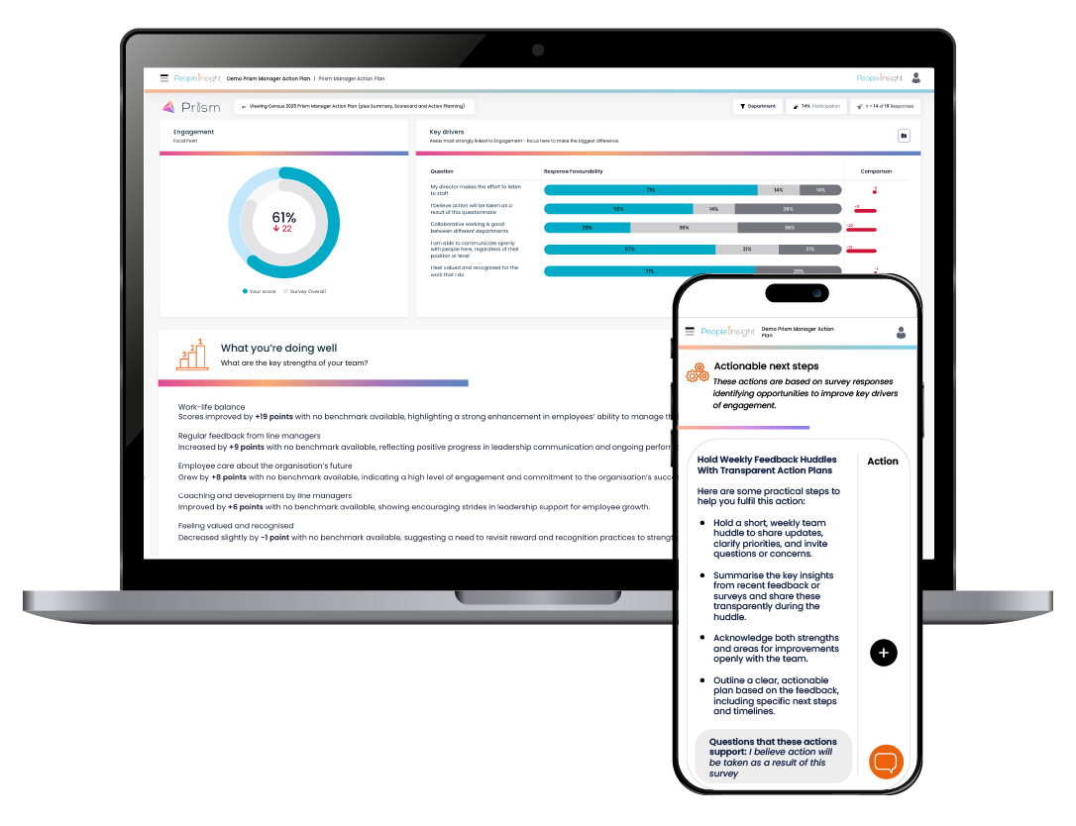
Prism Manager Action Plan
Summarises key insights and helps managers choose the right next steps
Provides smart, contextual recommendations based on survey results
Supports human-led action planning (managers remain in control)
Notes:
For the Prism Manager Action Plan, we send Prism:
the full set of qualitative comments for that manager’s team,
the question text - which is crucial for understanding polarity,
the quantitative results,
historic trends so it can see how things are changing over time,
comparisons to the rest of the organisation,
internal benchmarks,
the manager’s name and team,
the size and shape of that team, and
the organisation’s context.
HOW IT MANIFESTS
And we ask it to bring all of that together on a single page:
their strengths, their key areas of focus, and three recommended actions to move forward.
Not instructions. Not decisions.
Just clear, structured suggestions that help a busy manager make sense of their results quickly.
Like a sat nav
Like the map is not the territory

Slide 33


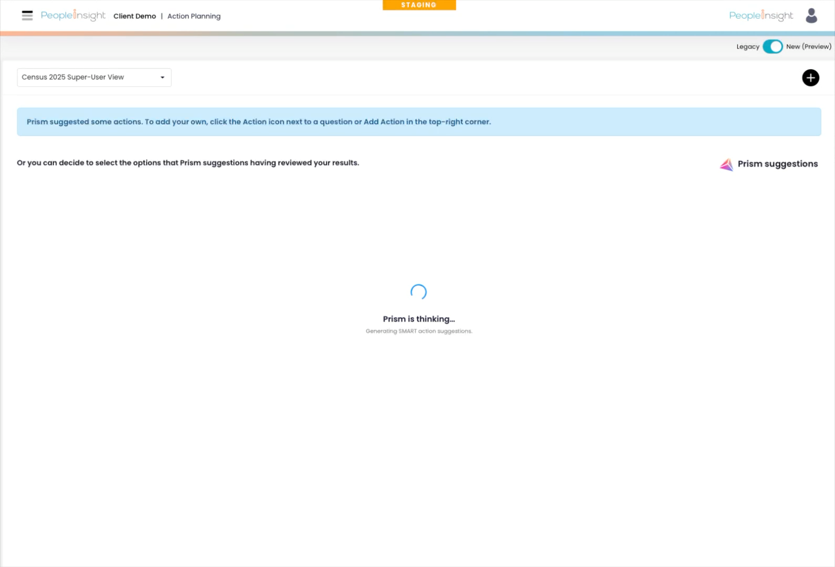
Upgraded action planning:
Smarter actions. Stronger culture.
Automatically surfaces three tailored action recommendations
Allows managers to generate actions for specific questions or results they want to improve
Prism Suggest creates high-quality actions from scratch or strengthens managers’ initial ideas for greater clarity and impact
Supports both team-level action planning and organisation-wide strategic initiatives
Notes:
WHATS NEXT - managers can choose any specific question or theme - whatever matters to them - and Prism can generate recommendations that match the level of focus they need.
CHOICE OF ACTION SUGGESTIONS
Sometimes that means tactical, team-level actions 0things a manager can do with their group in the next few weeks.
Sometimes, Ot means strategic, organisation-wide considerations - signals about culture, alignment, or systemic changes the organisation may want to explore.
The point of this phase is that managers now have a kind of context-rich, question-by-question interpretation engine that adjusts to the part of the dashboard they’re exploring.
So as consultants we are really excited about this development. It means managers across organisations have the chance to explore the dashboard on their own terms, dig into the questions that matter most to their teams, and get guidance that matches their context. Our role will become less about data interpretation and more about coaching and guiding managers to drive change

Slide 34
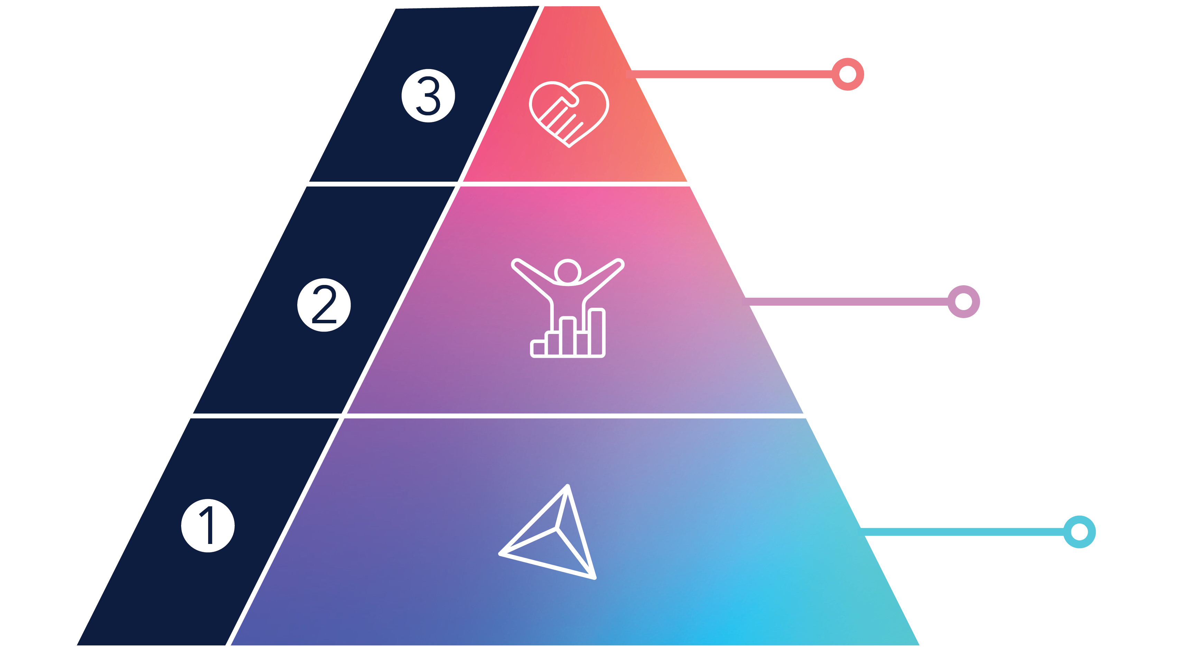
AI can do more but can’t replace what humans do best
Change happens together
Lasting improvement comes when AI accelerates the work and people drive action, trust and momentum.
Humans make sense of it
Apply judgement, understand culture and use behavioural insight to turn AI outputs into meaningful decisions.
AI does the heavy lifting
Processes data at scale, drafts starting points, suggests priorities and automates small, safe steps to accelerate progress.
Notes:
AI can do more of the heavy lifting, and that’s valuable, but the real impact only happens when you pair that intelligence with human expertise.
We should consider AI the base of employee listening, completing tasks that are essential for an effective listening cycle, but also the tasks that take the most time and often slow organisations down.
The next layer is the human layer: the judgement, the context, the interpretation of what feedback really means within your culture. This is where leaders and managers bring the understanding of relationships, tone, history and nuance that AI simply can’t replicate. It’s the difference between knowing what the data says and knowing what to do about it in your specific organisation.
And at the top of the pyramid is improvement: the behavioural change, the conversations, the decisions and the follow-through that actually move a culture forward. This is the outcome that matters most, and it’s only possible when the bottom two layers work together. AI accelerates the journey, but it’s people who bring the meaning and the leadership that make change real.
So when we talk about the future of employee listening, it’s not about choosing between AI and human expertise. It’s about creating a partnership where each strengthens the other: AI enabling speed and clarity, and humans bringing the insight and capability that turns that clarity into lasting improvement.

Slide 35
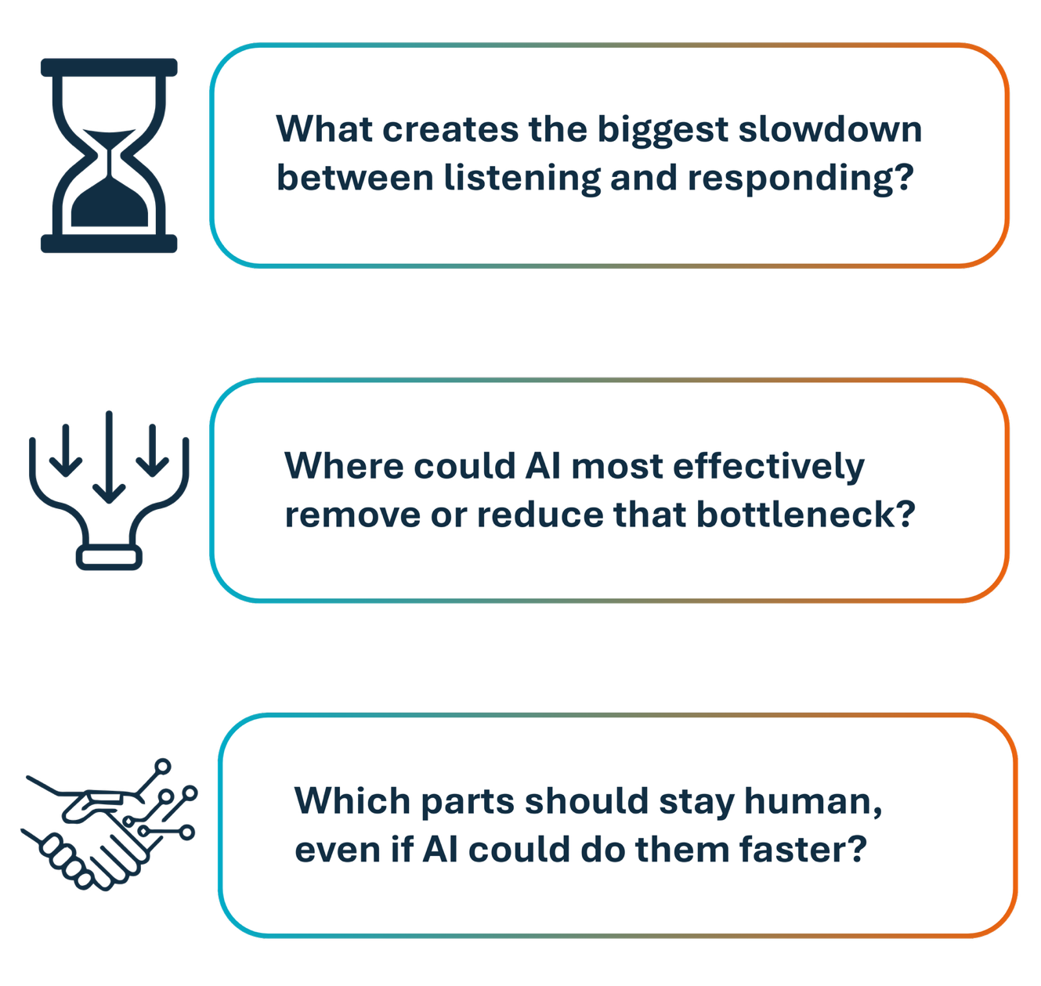
Key questions to discuss in small groups
20 mins for discussion
10 mins for feedback
Notes:
Feeding back
One place AI could genuinely help you to accelerate progress
One human responsibility that must be protected

Slide 36

LUNCH BREAK
1pm – 1.30pm

Slide 37
LJMU Staff Survey Journey
Trust Empowerment Engagement
Tina Purkis, Executive Director Human Resources
Andy Keegan, Head of Reward, Staff Engagement and Wellbeing

Slide 38
Agenda
Historic v.s current leadership
People Plan
Your Voice launch
Building trust & the role of the Executive Leadership Team
Local action plans & their impact
Challenges
Results

Slide 39

A look back….
Carried out in-house
Large amounts of data – Difficulties in analysis and time-consuming
Results kept within the Executive Group
No clear action plan
Unhealthy culture
Notes:
Tina – Highlighting the previous issues we have had with Staff Surveys

Slide 40

A new focus
Changes across Exec team including EHRD at the top table
Strategy – People Plan
  Engagement critical to success
KPI’s underpin/track staff survey
Notes:
Tina – Change ELT membership/ new staff joining the team, HR having a seat at Exec, enabling influence.
-Gap due to covid
Development of People Plan, Engagement a central driver,
How we track its impact on the university through KPI’s etc

Slide 41
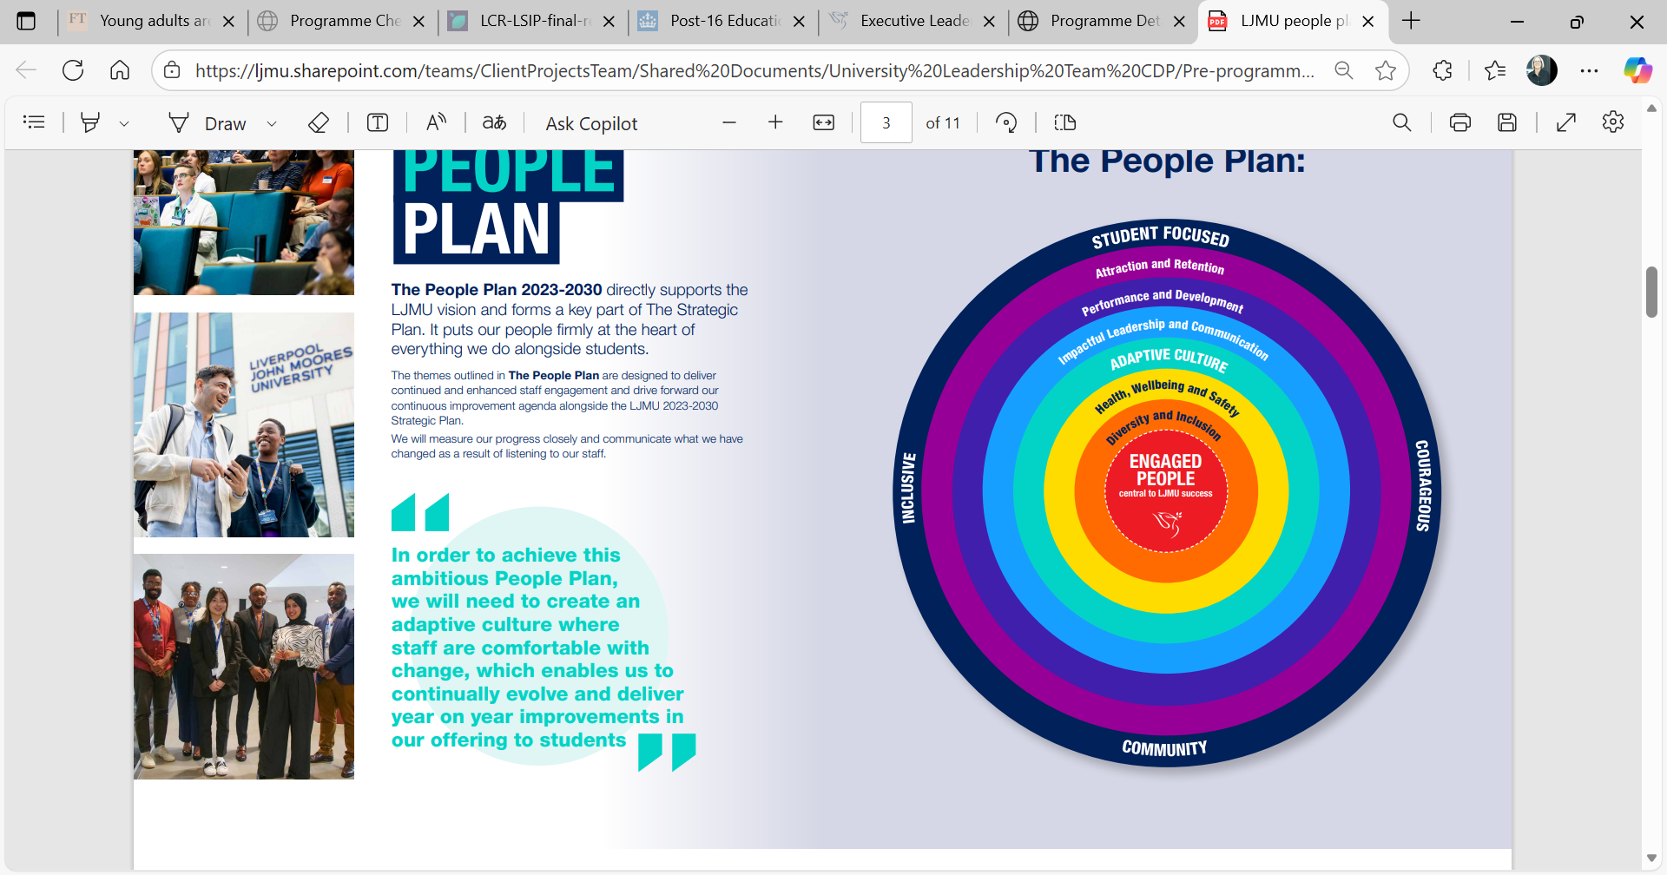
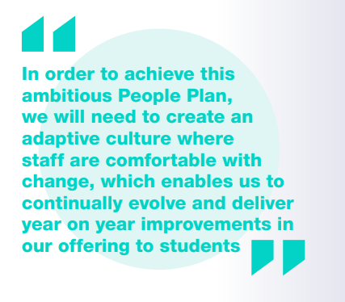
The People Plan
The People Plan 2023-2030 directly supports the LJMU vision and forms a key part of The Strategic Plan. It puts our people firmly at the heart of everything we do alongside students.
ELT Strategic Priorities 2025/26:
Undertake a comprehensive portfolio review
Implement a high-quality teaching framework
Secure strong continuation rates for all students across all levels and modes of study
Improve the efficiency and effectiveness of the University’s operating model
Build leadership capability and enhance the staff experience

Slide 42
Leadership Culture Change
Solid & Resilient Relationships
Shared Purpose
Inclusive Leadership
Adaptive Culture
Diverse empowered teams
Relationships that can withstand challenge
Understanding of our shared purpose & the role we each play in delivering the strategy
Confidence to lead through change at pace
Improved communications and engagement processes for ULT & our teams
A clearly defined and articulated LJMU inclusive cultural framework
One courageous team of senior leaders capable of taking on the future of HE

Slide 43




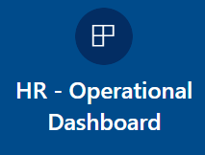


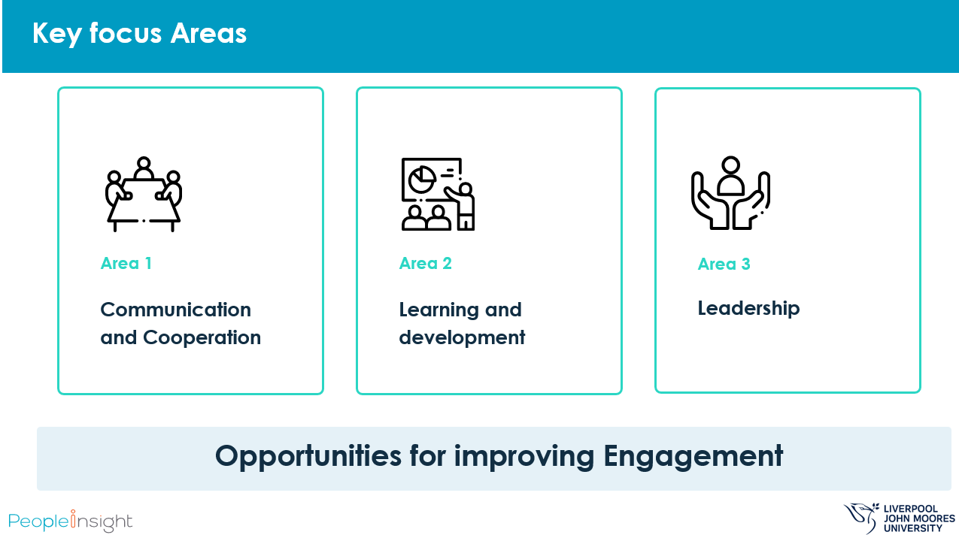





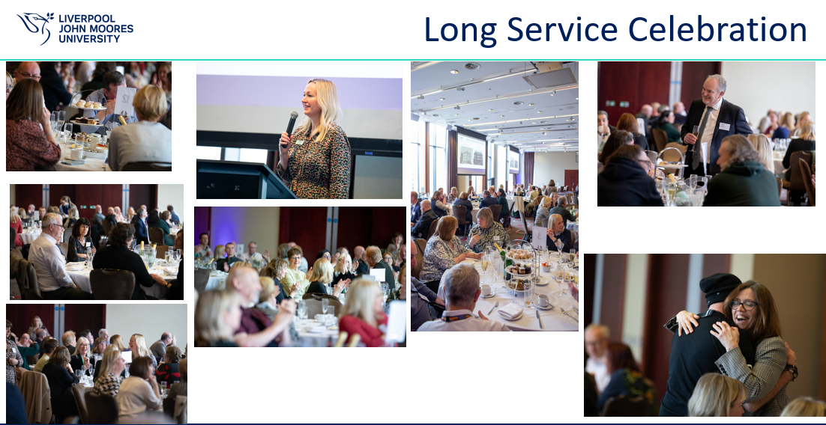




People Plan - Activity
Notes:
Tina – Activity linked to staff survey captured also under the thematic areas of the people plan

Slide 44


2023 Staff Survey Returns
Your LJMU Your Voice
Ensuring anonymity
Enabling Directorate Access
Meaningful Action Planning
Targeted Comms
Notes:
Andy – preparing to launch a new survey, ensuring the concerns of past are reflected in practice of the new one.
-Drivers we wanted to achieve when considering our provider.

Slide 45
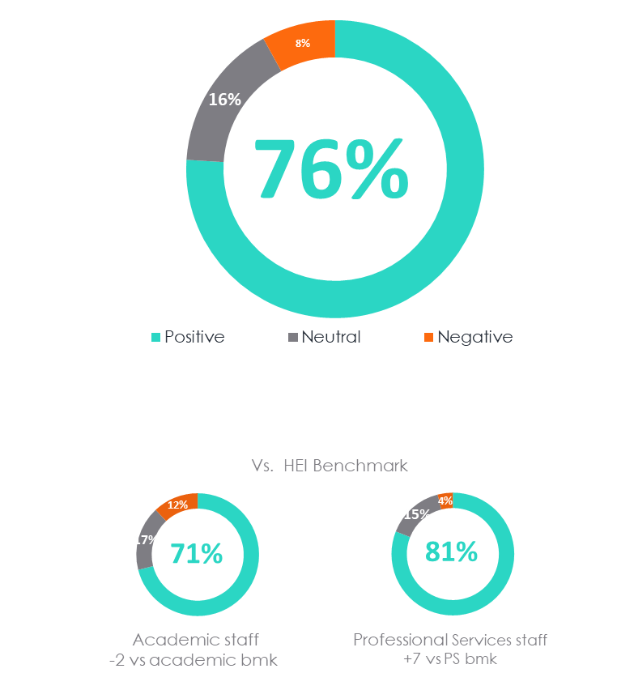
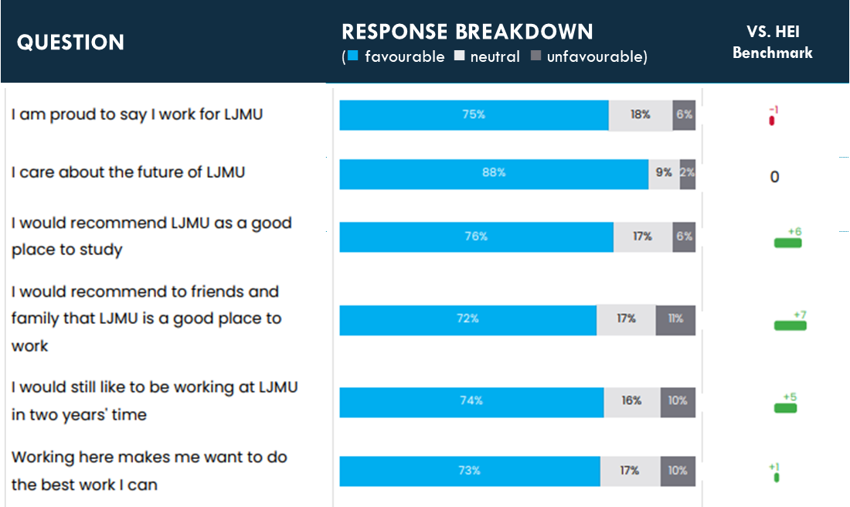
2023 Results (53% participation)
40%
Belief in Action
Notes:
Andy – Very much a line in the sand and a starting point for us to understand feeling and build upon.
- Timing cost of living crisis, UCU strike etc mindful of impact

Slide 46
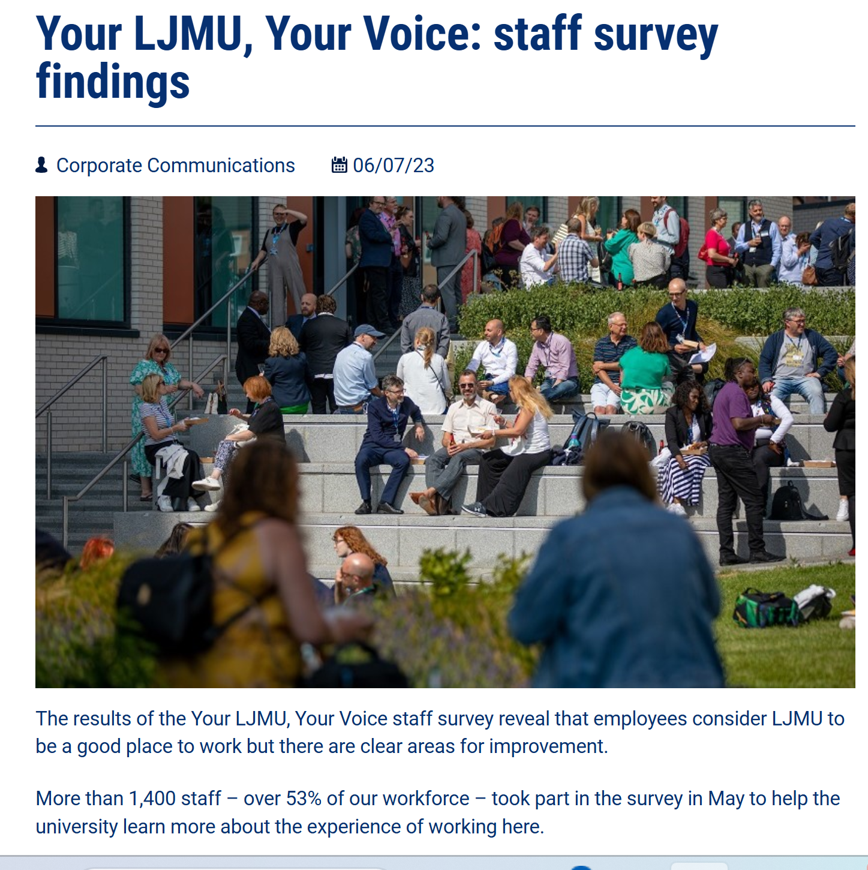
Building Trust
Results shared with Executive and Directorate same day
Kate Pritchard leading feedback session
Full access to comments, encouraging ownership
i-Deck – easy to share key findings
3 Actions
Staff comms shared early
Notes:
Andy – how we ensured the survey was taken seriously, key results shared quickly, People Insight supporting dissemination

Slide 47
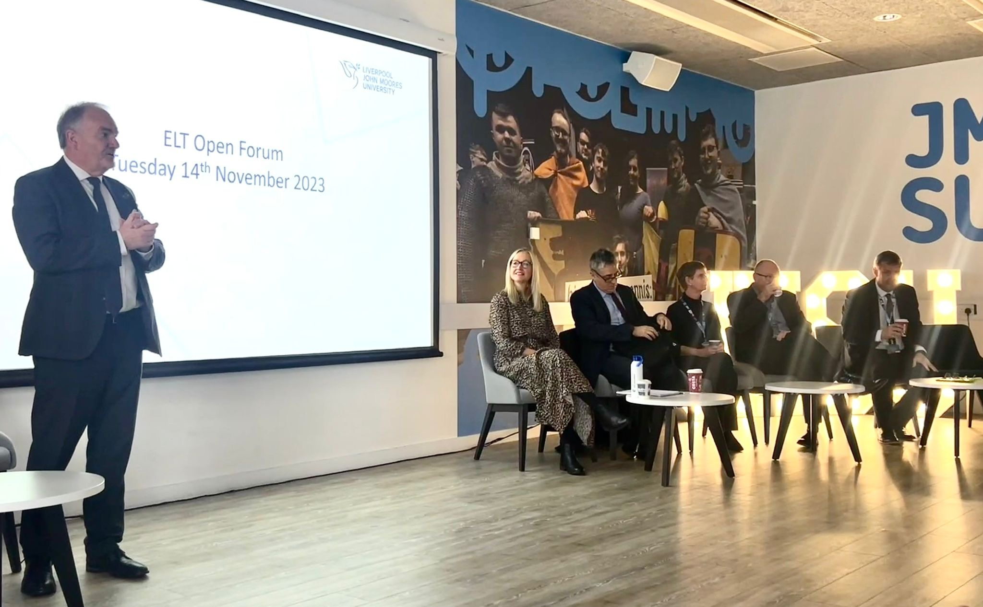
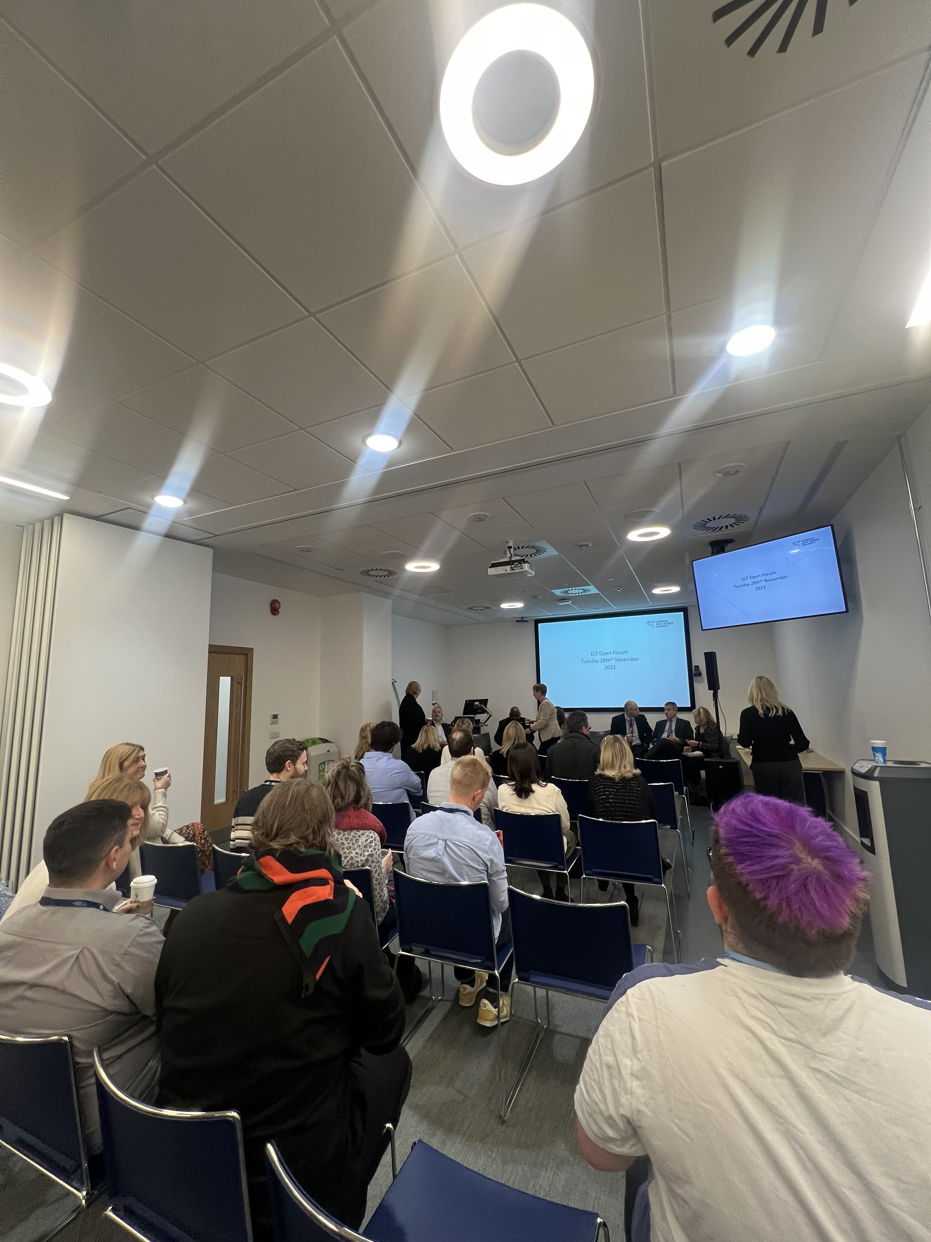
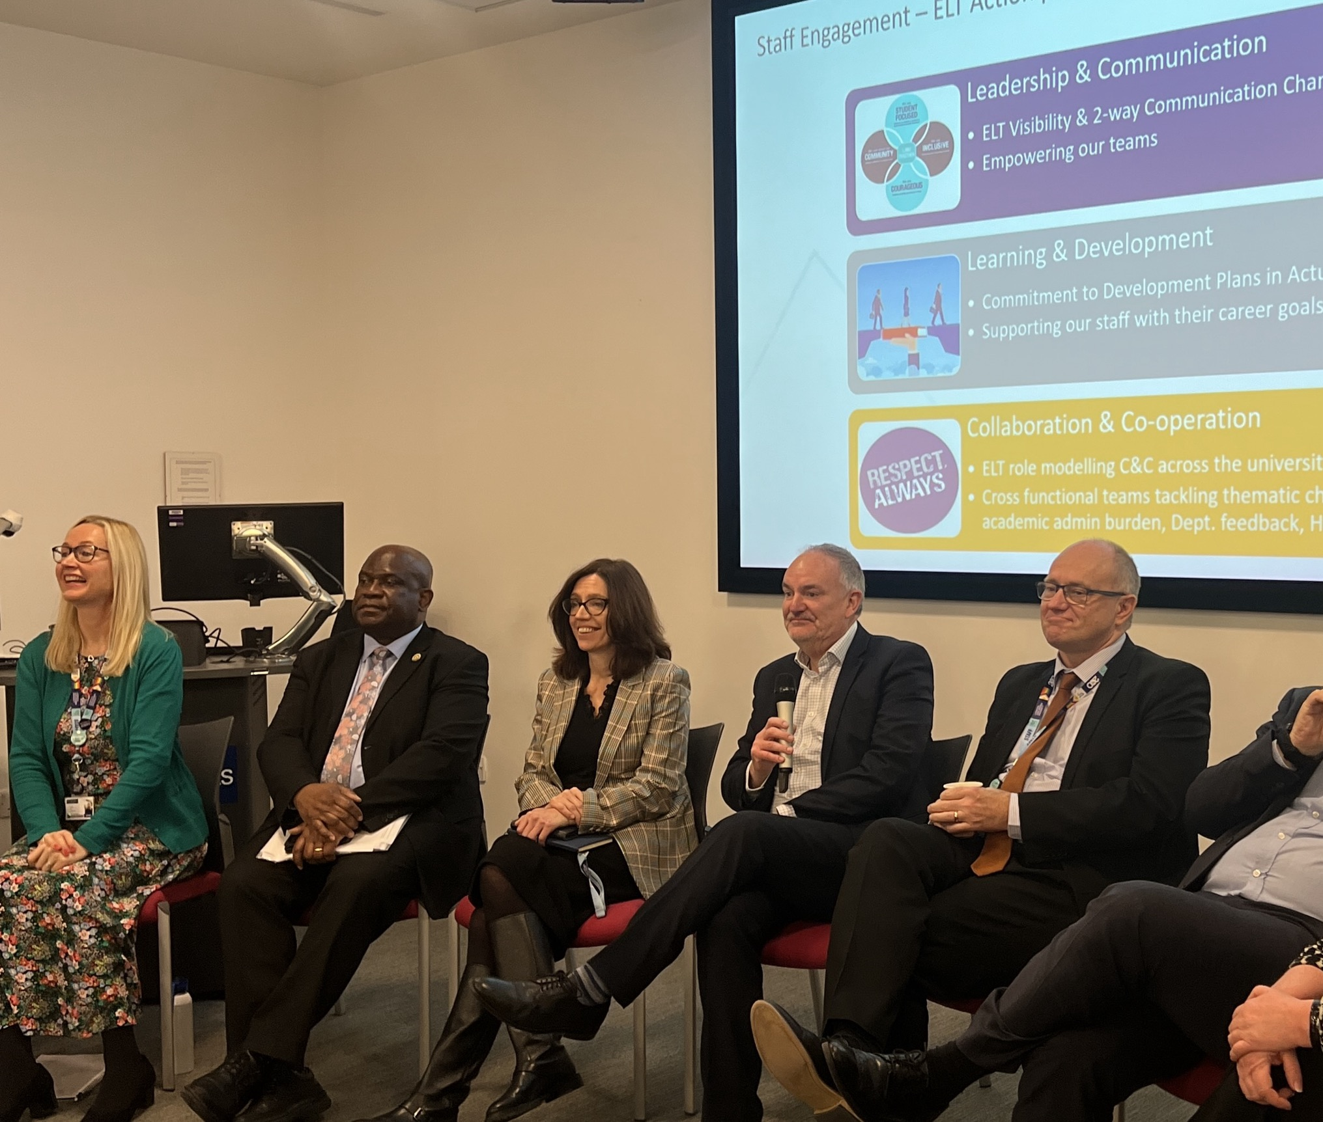
2023 Institutional Actions & Executive Leadership Team Role
Leadership & Communication
ELT Visibility & 2-way Communication Channels
Empowering our teams
Learning & Development
Commitment to Development Plans in Actus
Supporting our staff with their career goals
Collaboration & Co-operation
ELT role modelling C&C across the university
Cross functional teams tackling thematic challenges e.g. academic admin burden, Dept. feedback, Helpdesks etc.
Notes:
Tina – University Actions - how ELT took a lead on this.

Slide 48
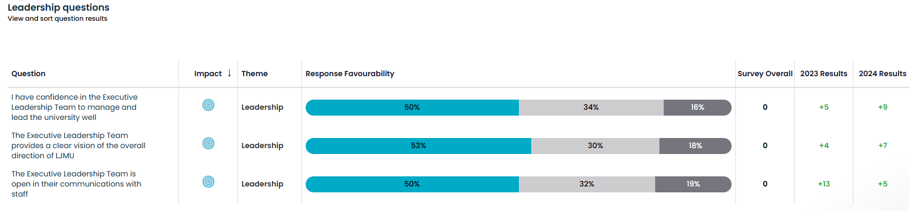
Leadership Scores
t
2023
2024
2025
43%
44%
51%
Notes:
Tina – Increase in leadership scores across the surveys, response to the actions ELT have taken.
- Shows the 3 questions that make up the leadership scores and how these have increased year on year for each

Slide 49
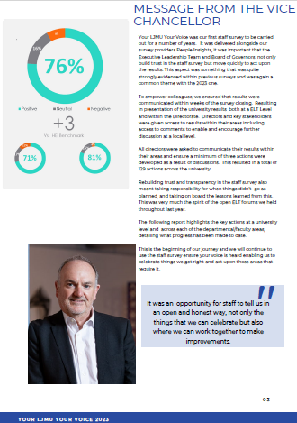
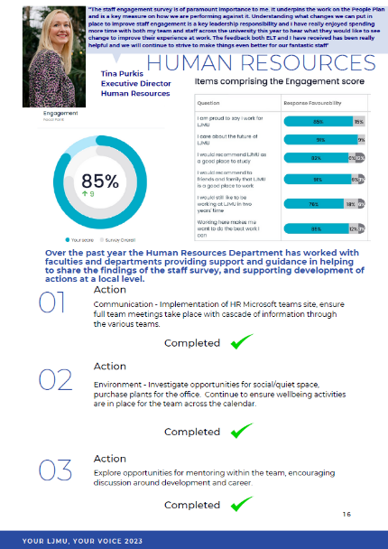
Building Blocks of Success
You said, we did…
2024 enabled all staff access to the platform, sharing university and local area results
Ensuring local focus groups and feedback are in place
HR Business Partners helping to drive change at a local level
Actions – (not always the big-ticket wins)
Staff communications critical
  Online
  From the VC & Executive
  Line managers
t
Notes:
Andy - key points on how we have begun to build the foundations that have helped contribute to the scores increasing year on year.
Staff Comms repeated as a theme throughout the presentation to highlight its importance – Keep communication either via LJMU media channels, Exec or Managers

Slide 50



2024 Institutional Actions
Leadership
ELT open forums (‘Plan on a Page’ strategy).
Implement a Leadership Development Programme (Directorate).
Review the Scheme of Delegation (empowerment and autonomy for the Directorate).
Encourage the Directorate to lead, plan and decide on discussion topics for the Directorate meetings.
Valuing staff
Review of all recognition events, possibly bringing these together in one event.
Encourage a ‘thank you’ culture using such opportunities as Instant Rewards (financial) and thank you notes (non-financial).
Ensure meaningful conversations regarding career development and aspirations take place and are recorded within Actus.
Collaboration
Foster a culture of openness and transparency and establish an environment where staff feel encouraged and psychologically safe.
ELT / Directorate role-modelling culture of being courageous.
  - encourage stronger collaboration between departments and schools, and continue with customer service reviews across Professional Services.
Notes:
Andy

Slide 51
2024 Local Actions (154)
Digital Collaboration – use of teams, internal comms, celebrating success
Management Support – line managers providing consistent support and direction of their teams
Development – encouraging discussions around career development/opportunities
Operational Efficiency – review of processes and systems
Inclusion – ensure Diversity and Inclusion objectives are embedded at a local level
Wellbeing – continue initiatives supporting staff wellbeing, promotion of work-life balance, review of workload allocation
Notes:
Andy

Slide 52


2025 University Actions
Career development
Develop a university communication plan that clearly captures developmental and progression opportunities for both Academic and Professional services colleagues.
ELT to champion mentoring and coaching within their areas, ensuring colleagues engage with opportunities available. Encouraging management to register as mentors where possible.
Ensure best use of existing university systems e.g. Actus and Linked in Learning
Line management
ELT to ensure that all line managers engage in line management training programmes available across the university.
ELT to champion and embed a culture of recognition ensuring managers embed everyday recognition into team routines. (verbal praise, team shout-outs and celebrations for exceptional work).
Health and Wellbeing
Review academic workload and identify opportunities for efficiencies.
Run focus groups with staff to gather input on what changes would have the greatest impact and to explore innovative suggestions.
Notes:
Andy

Slide 53
Challenges
60%
1669 / 2803 responses
Notes:
Andy – Academic participation challenge.
- Highlight plans for engaging estates in 2026 survey.

Slide 54
LJMU Voice
“The working culture is very welcoming. I have an excellent relationship with my colleagues which makes coming to work enjoyable.”
“The people, the support, the students and the ability to make a difference to people's lives.”
“I love working at LJMU, there is a real community feel about it and I feel valued in my role, I also feel they put great emphasis on my well being, and provide lots of opportunities for me.”
“Making a difference to the lives of students and their future career – which will impact on the broader community.”

Slide 55
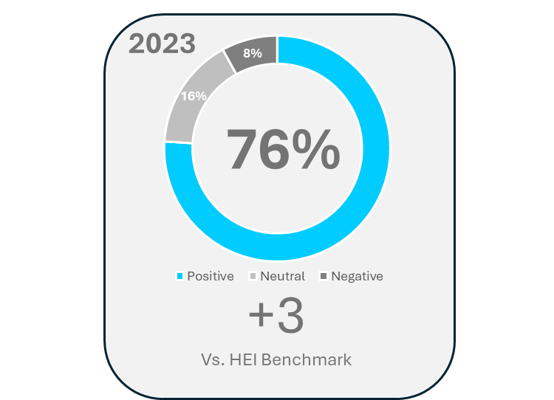
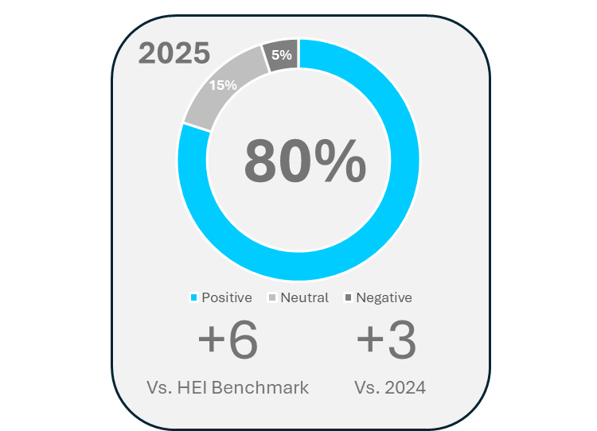
Results
53% response rate
63% response rate
60% response rate
2024
+4
Vs. HEI Benchmark
+1
Vs. 2023
40%
46%
49%
Belief in Action
Belief in Action
Belief in Action
Notes:
Tina - finish on the positive slides how we have increased across the years?

Slide 56

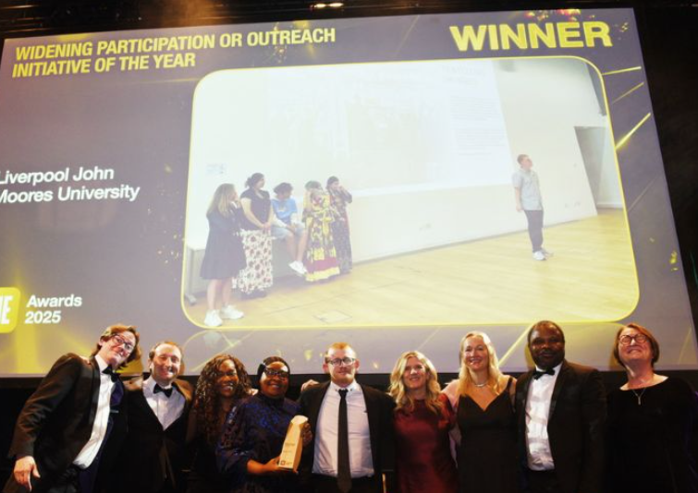
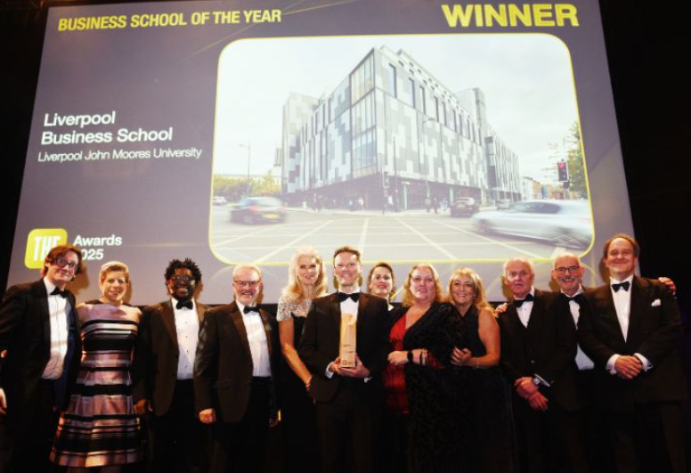


We’re in a great place….
Trust
Empowerment
  Leadership
  Influence
Engagement Results

Slide 57
Questions
Trust Empowerment Engagement
Tina Purkis, Executive Director Human Resources
Andy Keegan, Head of Reward, Staff Engagement and Wellbeing

Slide 58
Best Practice Exchange
Workshop
Kate Pritchard
People Insight
2.15pm - 2.45pm

Slide 59
Best Practice Exchange
Discuss in groups:
If you had a magic wand to improve one thing about how we listen to and engage with staff, what would it be?
How could managers be better set up to own local action planning?
2.15pm - 2.45pm

Slide 60

Feedback

Slide 61
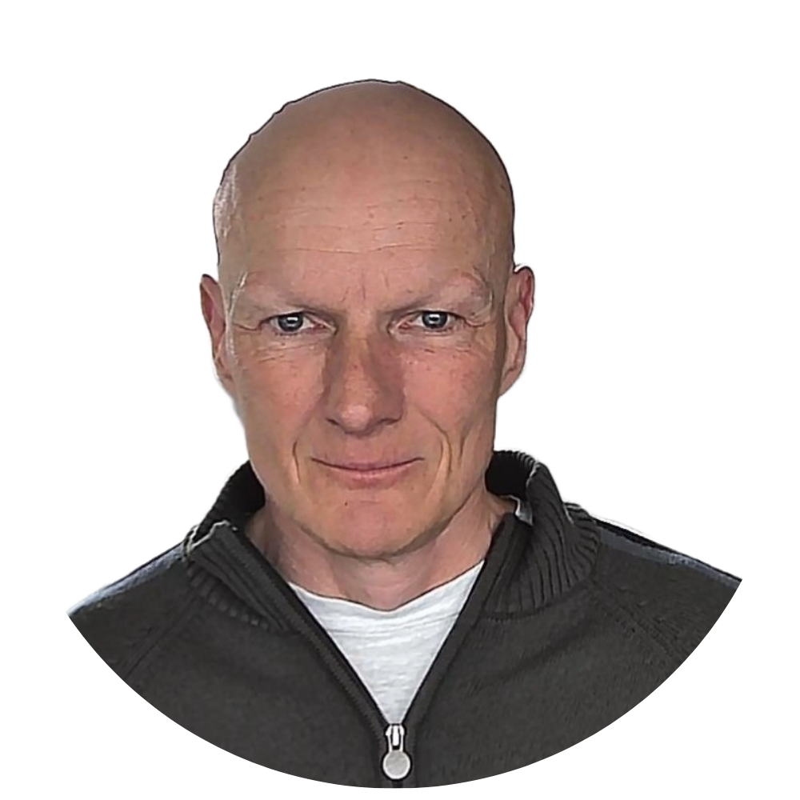
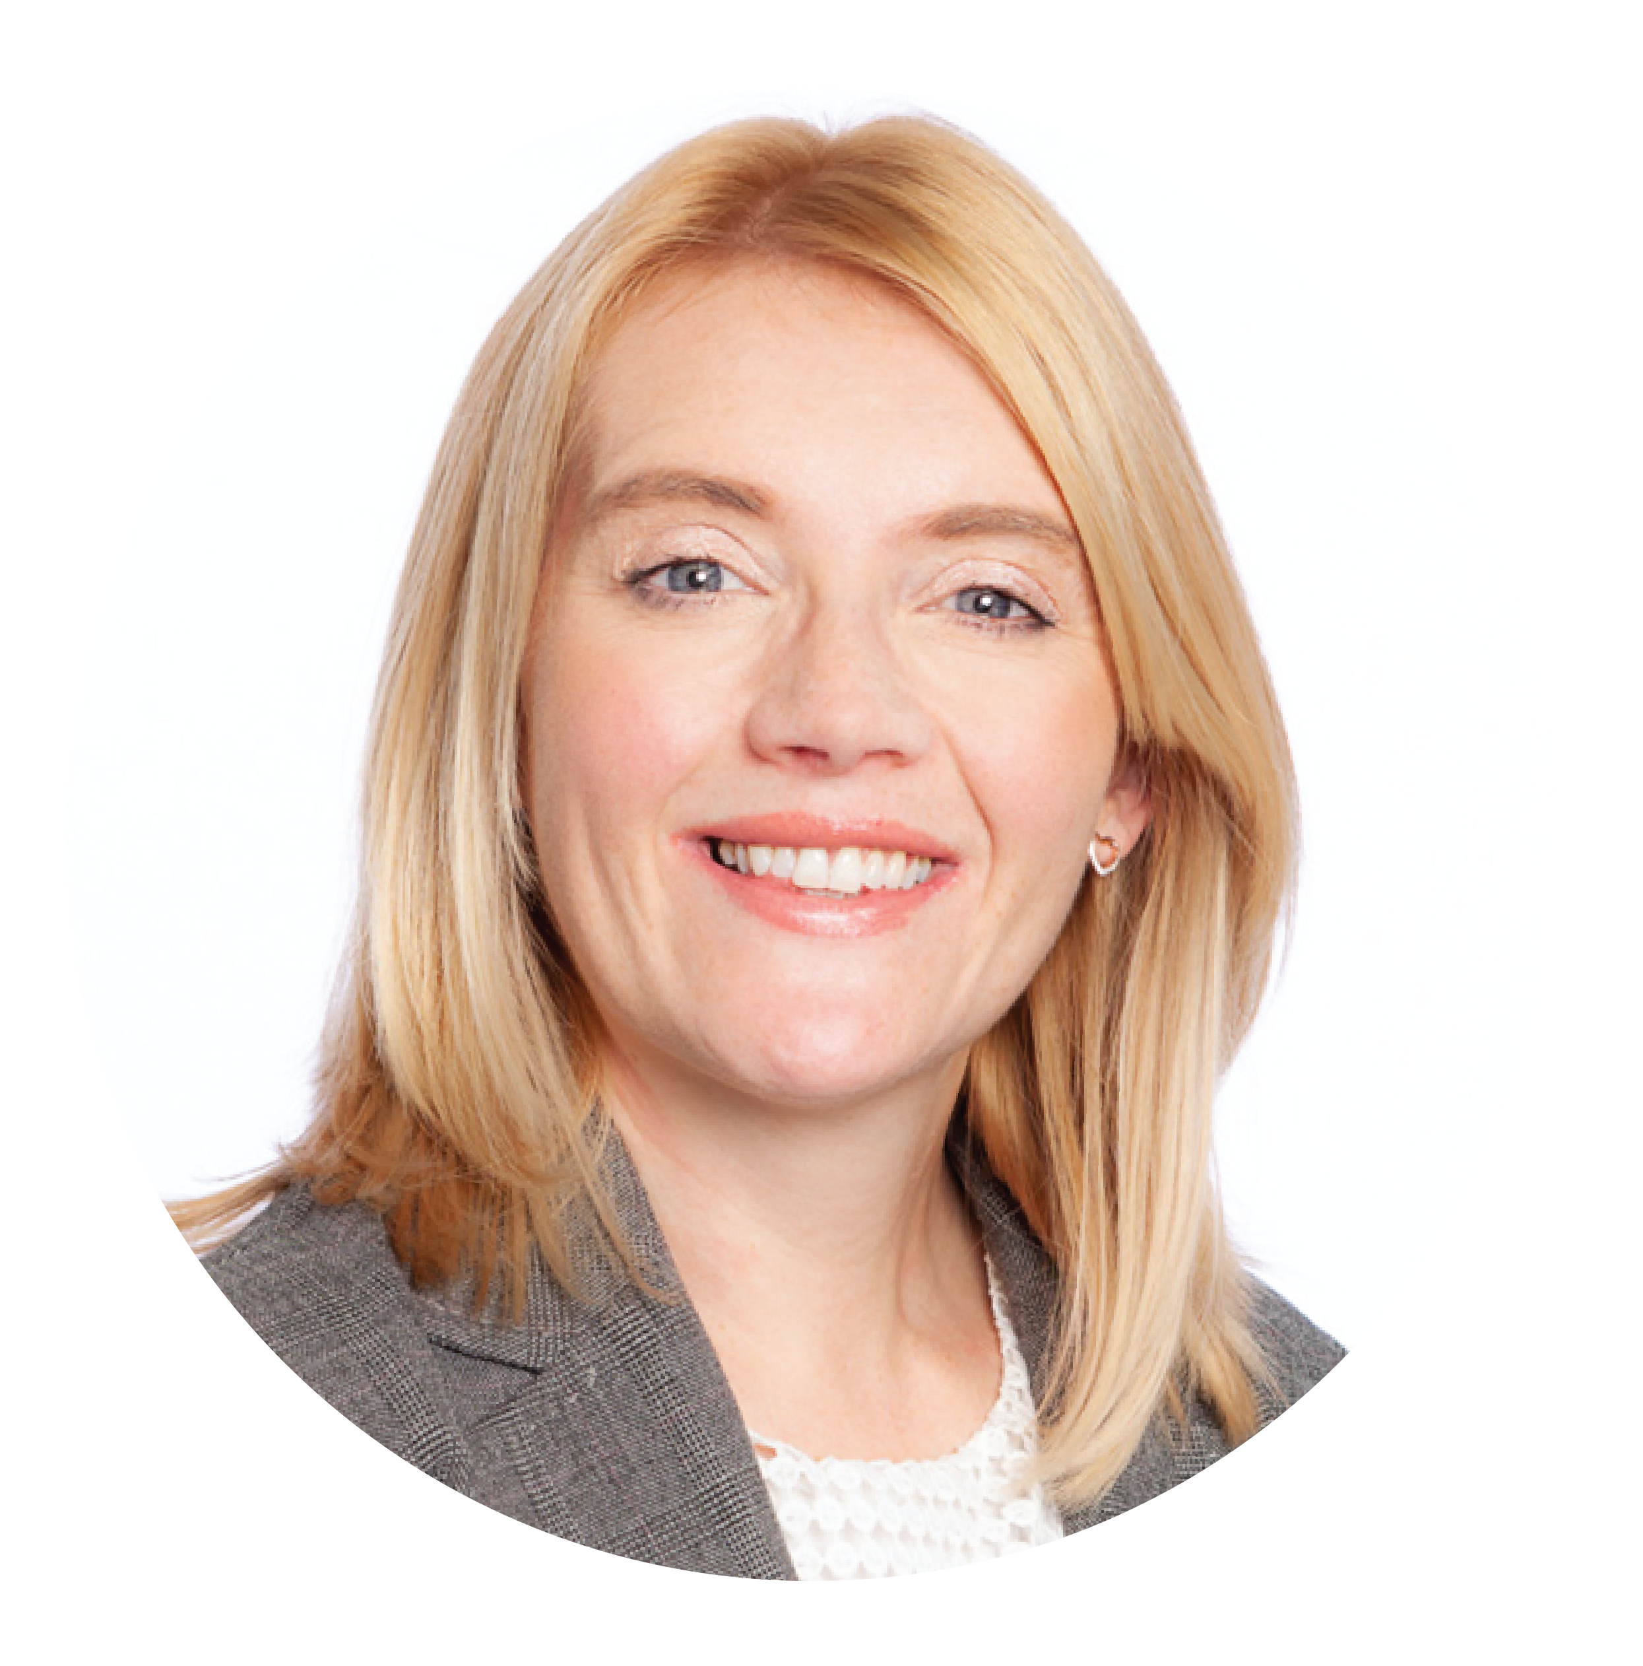
Closing reflections
Jane Tidswell & Tom Debenham
People Insight
2.50pm – 3pm
Notes:
Get Involved:-
Microsoft teams site for existing clients
Newsletter
In person events and webinars

Slide 62

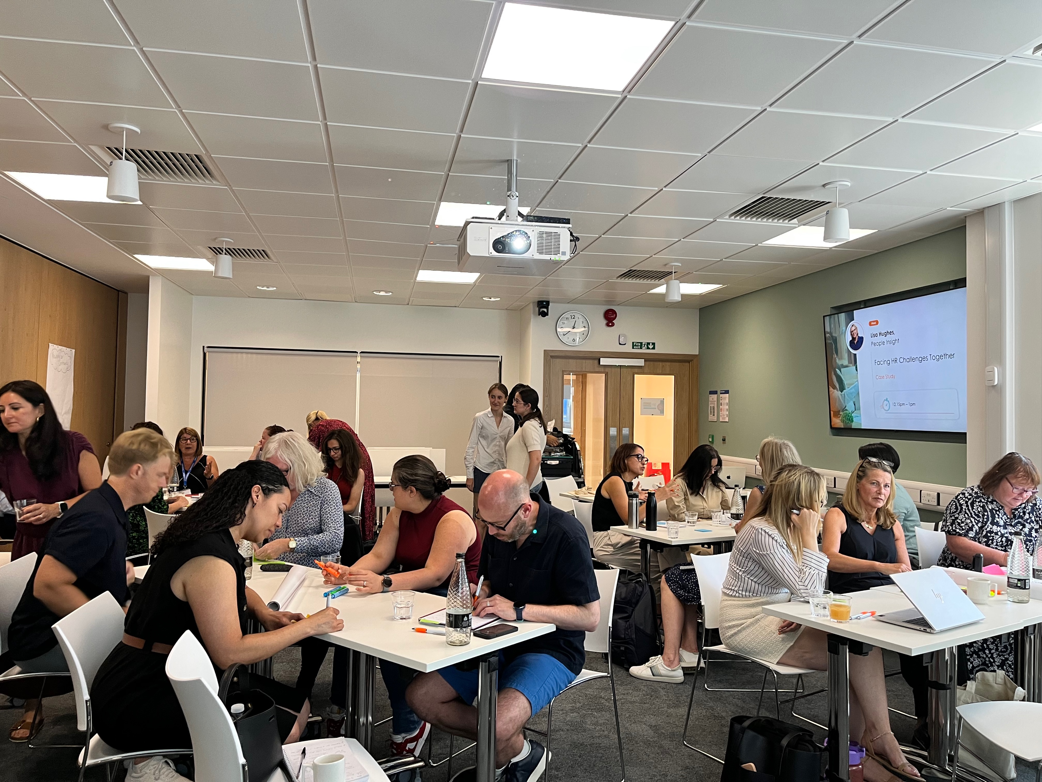

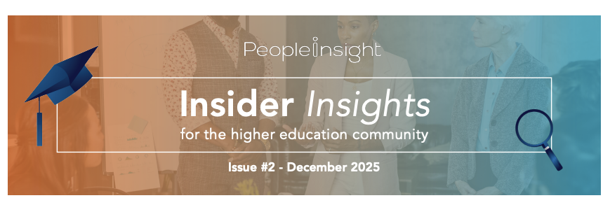

Looking ahead to 2026…
HE Microsoft Teams community
Face to face & virtual events
Next virtual webinar = 12th March 2026 (11.30am – 12.30pm)
Releasing 2025 ranking to individual unis and collecting data for 2026
“Insight to Impact” face-to-face event in Summer 2026 featuring inspire HE 2025 winners sharing their stories and best practice
Monthly newsletter
Notes:
Can we add in annual trends report - when will we release this - by the end of march? Or I can say this?

Slide 63
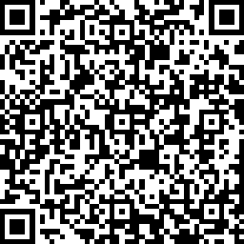
Give us your feedback
https://say.peopleinsight.co.uk/PeopleInsight/NTNIRL2026
Notes:
Updated QR code & link

Slide 64
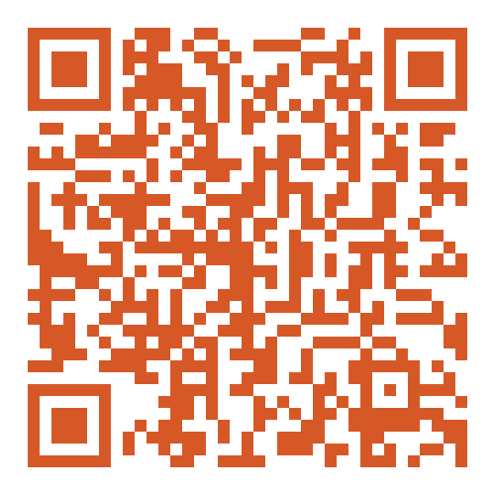

Let’s keep the conversation going
Connect on LinkedIn
enquiry@peopleinsight.co.uk
Jane.Tidswell@peopleinsight.co.uk
Suzanne.Christopher@peopleinsight.co.uk
Let us know if you want to be part of the HE Teams channel.

Slide 65


Rooting for change
Last year,
we planted 15,495 trees.
In 2024 alone, they:
Opened a plant nursery in Mozambique with an annual production capacity of 500,00 seedlings and provided full-time employment for 24 local men and women
Planted 175,000 trees in the Mau Forest of Kenya
By contributing in 2025, we are actively aiding their restoration efforts with:
Indigenous tree planting in appropriate areas
Applied nucleation to accelerate forest recovery
Assisted natural regeneration
We’re planting a tree for each attendee in today’s session!
Notes:
As many of you may know we partner with Eden: People+Planet, which is a nonprofit organization dedicated to restoring degraded landscapes and combating deforestation.
Eden partners with local communities to co-design and implement restoration projects. This ensures that the efforts are sustainable and beneficial to both people and the environment . They provide fair-wage employment to thousands of local community members, helping them plant, grow, and protect millions of trees each year
Last year alone we planted over 15,000 trees and have supported community projects and land restoration. For attending the session we will be planting a tree for each attendee so thank you.

